Slide 1
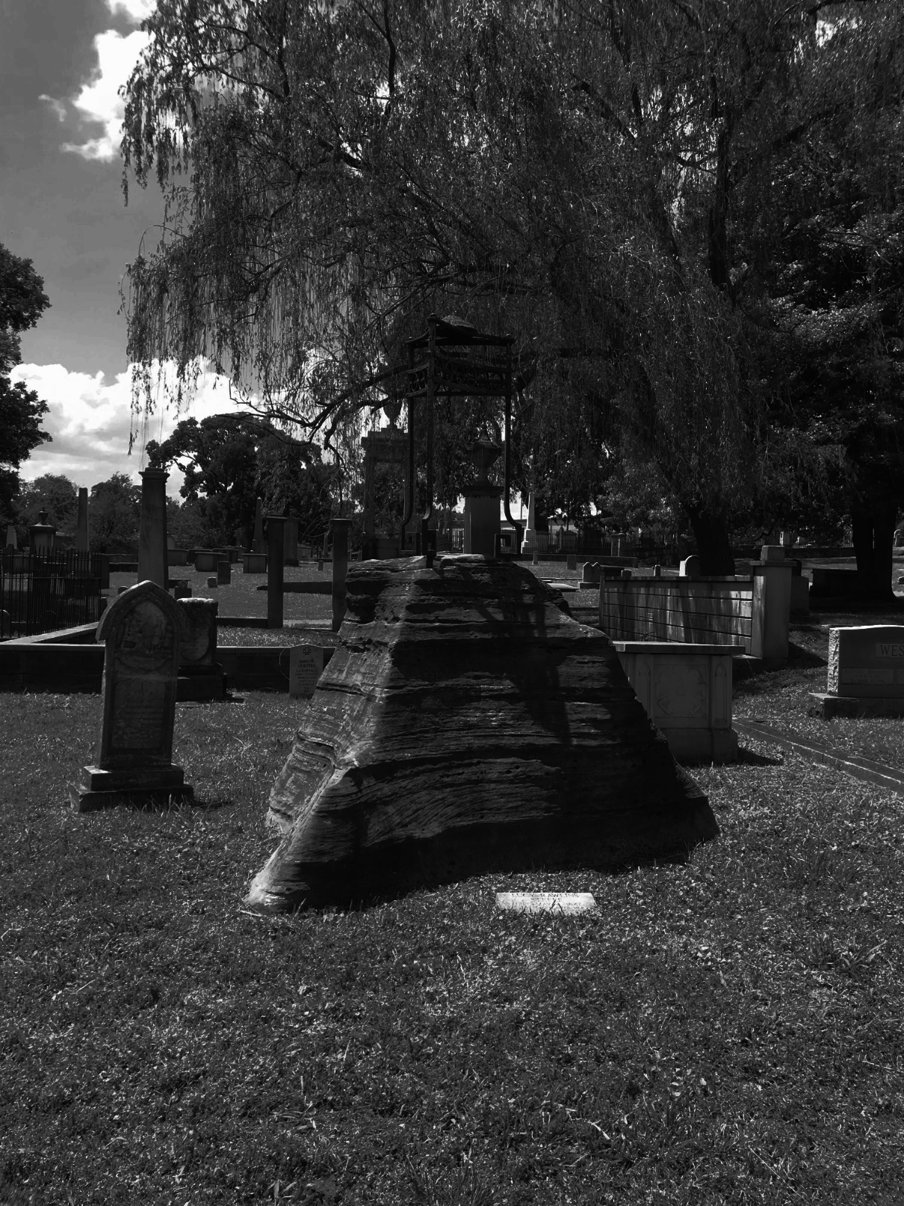
Exploring the history of Nashville’s Historic city Cemetery
A walk Through Time
Presented by: Cyrus Gilchrist Director of Nashville Tourism
Date: 01-16-2025

Slide 2
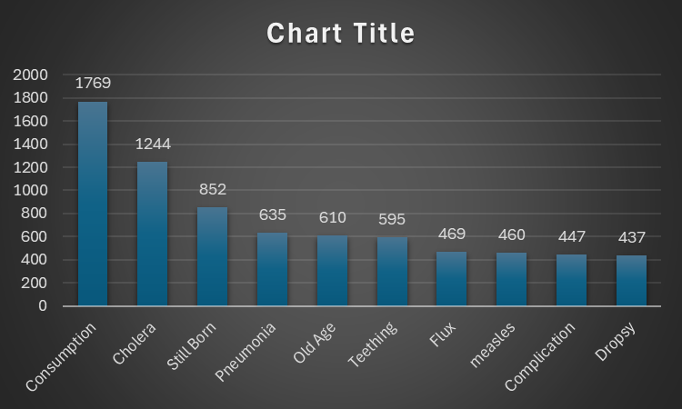
Established in 1822 Nashville’s Historic Cemetery is Nashville's Oldest outdoor Museum!
Through research of mostly handwritten documents we can study the past learning about common illness, literacy, racial equality, and even the brutal effects of the Civil War. Below I have ranked the top ten illnesses recorded from 1846-1979. (Important to note that I’ve excluded Unknown and Not Known which were also in the top ten originally).

Slide 3
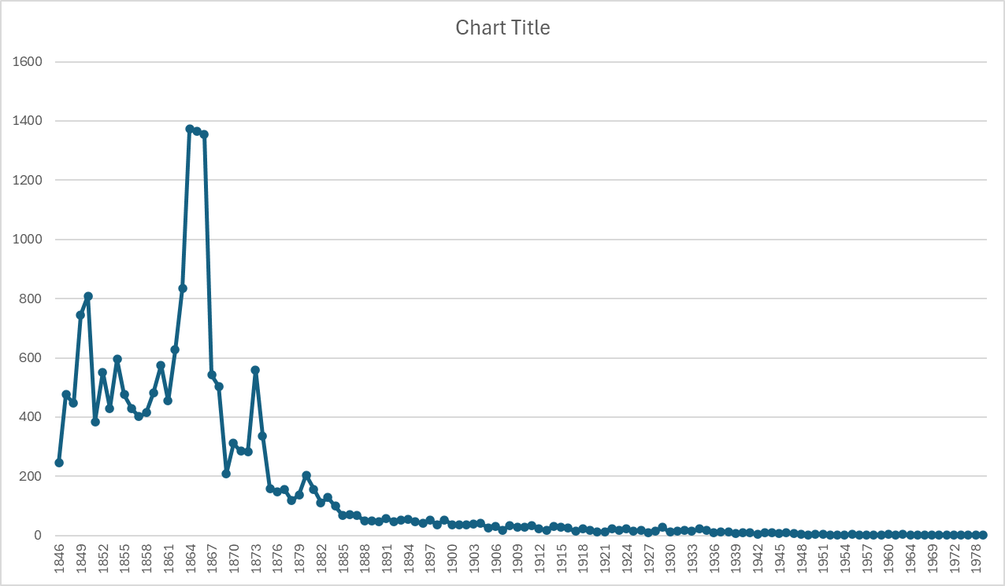
Nashville’s Historic Cemetery Had to Expand in 1856 to accompany all of the graves. Covering 27 acres and over 20,000 graves.
As you can see there was a huge spike in Burial’s between year 1864-1866. This could be a result of two major events. The Civil War which reigned on from 1861 to 1865 including the battle of Nashville which killed over 6000 confederate soldiers in two days! (Dec 15-16 1864). The second event took place in september of 1866 which began the cholera epidemic! “The Blue Death”

Slide 4
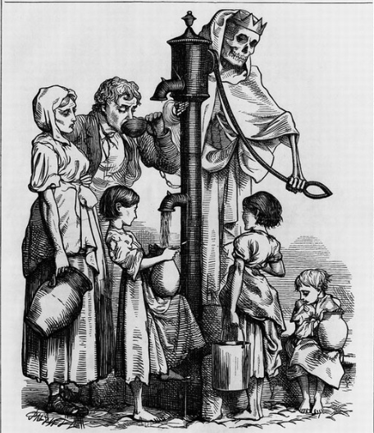
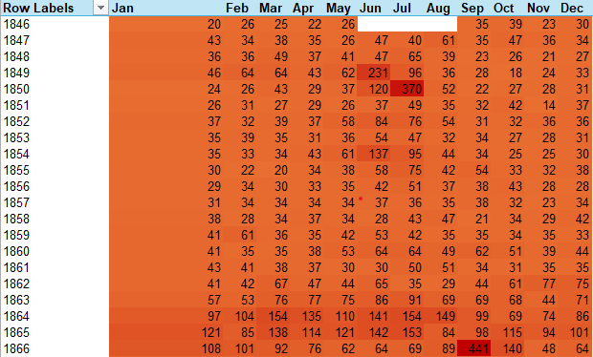
September of 1866 had more burials than any other month of any year. Most people affected by the Cholera epidemic where Immigrants and African Americans who were living in the Reconstruction areas from the civil war. These areas where in rough condition resulting in poor living conditions lacking in clean water and proper hygiene.

Slide 5
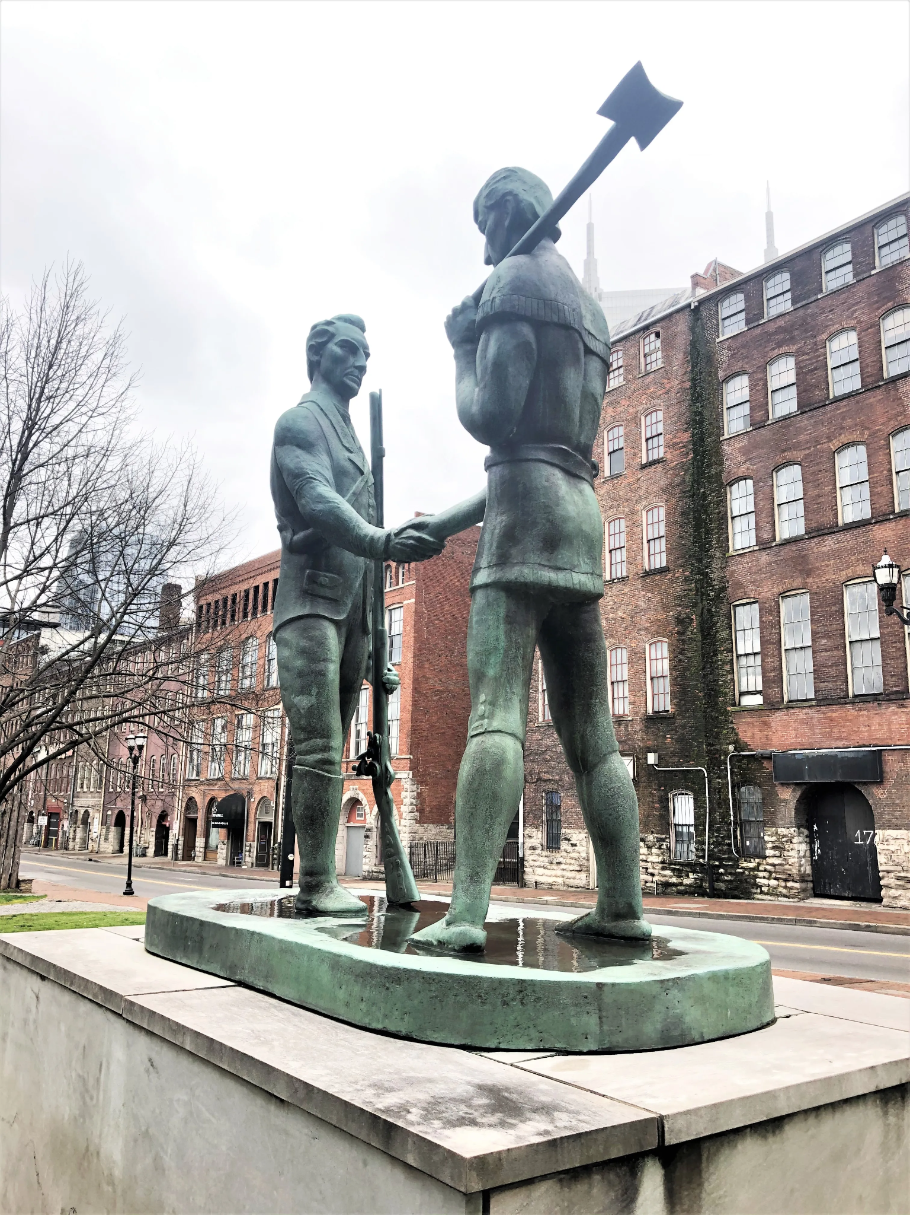
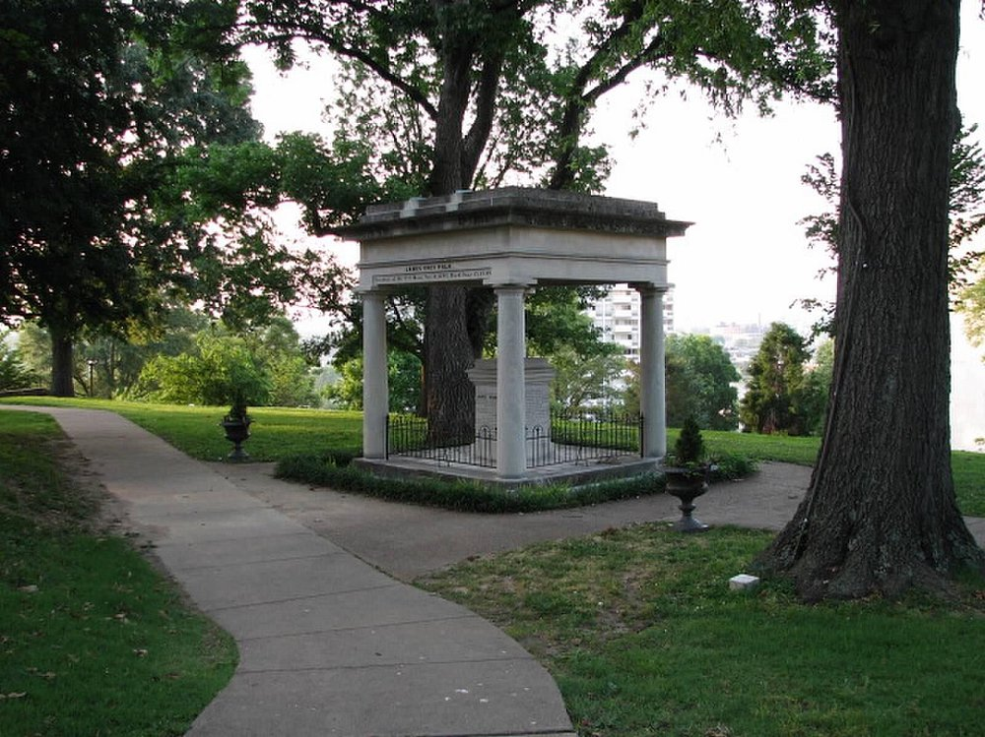
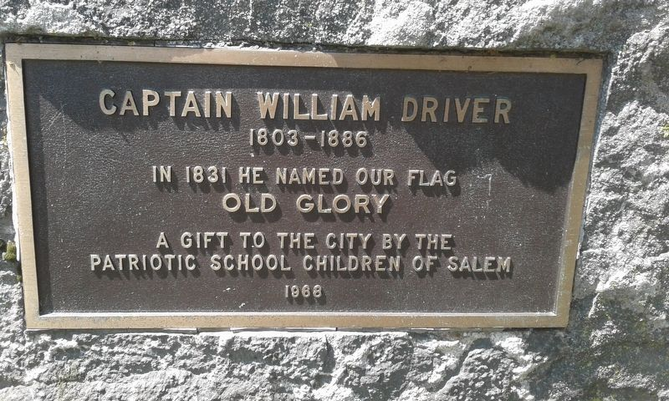
There are a few notable individuals buried at Nashville City Cemetery.
Captain William Driver who coined the name “Old Glory” for the US flag.
James Robertson who is recognized as one of the founders of Nashville.
President Polk, J.K. (whose remains have been moved and placed under his personal monument)
Mabel Imes and Ella Sheppard who were singers playing a crucial role in preserving and promoting African American Spiritual practices.

Slide 6
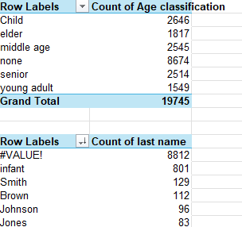
Although there are a few popular and influential people buried here we also know that there is a very large number of children and infants buried here that were never even named.
Excluding “none” we can see that Child was one of the higher burial rates. (children under 18)
A large amount of #Value! Returns were infants of…… Meaning a significant increase in the “infant” count.

Slide 7
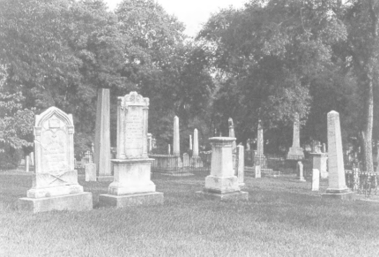
Nashville City Cemetery Is a place worth Preserving. A historically significant location that gives us insight to social and economic disparities, war torn cities, disease and medical practices of the 18th and 19th century. Nashville city cemetery was put on the National Register of historic places with restoration started in 2006 which is now complete.

Slide 8
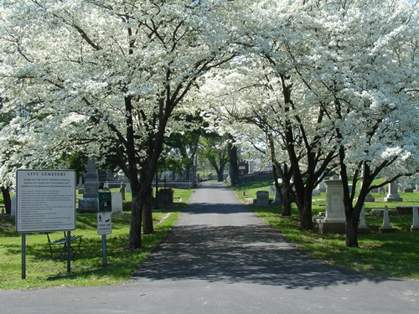
A day in the park? How about a day at the graves?!
Come and explore Nashville's largest outdoor Museum with activities such as historical walking tours, outdoor scavenger hunts, a civil war tour, and even the annual weed wrangle. Or feel free to relax with the dead and enjoy the beauty that the master gardener’s have created amongst the unique historical monuments.

Slide 9
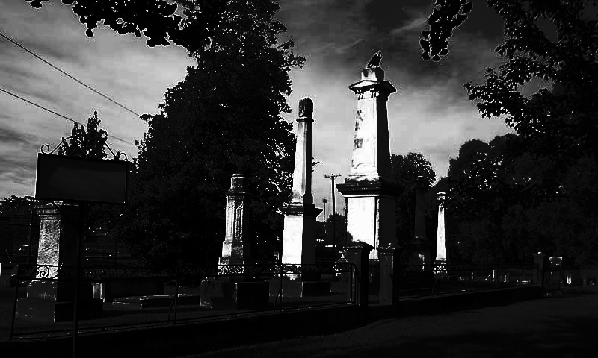
https://thenashvillecitycemetery.org/cemetery-history
The Nashville Historic City Cemetery is more than a resting place; it is a living testament to the city’s rich history.
Through the good work of the Sexton’s we were able to collect and keep data. This data allows us to study, learn, and educate future generations. The Nashville Historic Cemetery is a beautiful place of reflection, remembrance, and heritage. Come Explore the history and take a walk through time.

